Slide 4
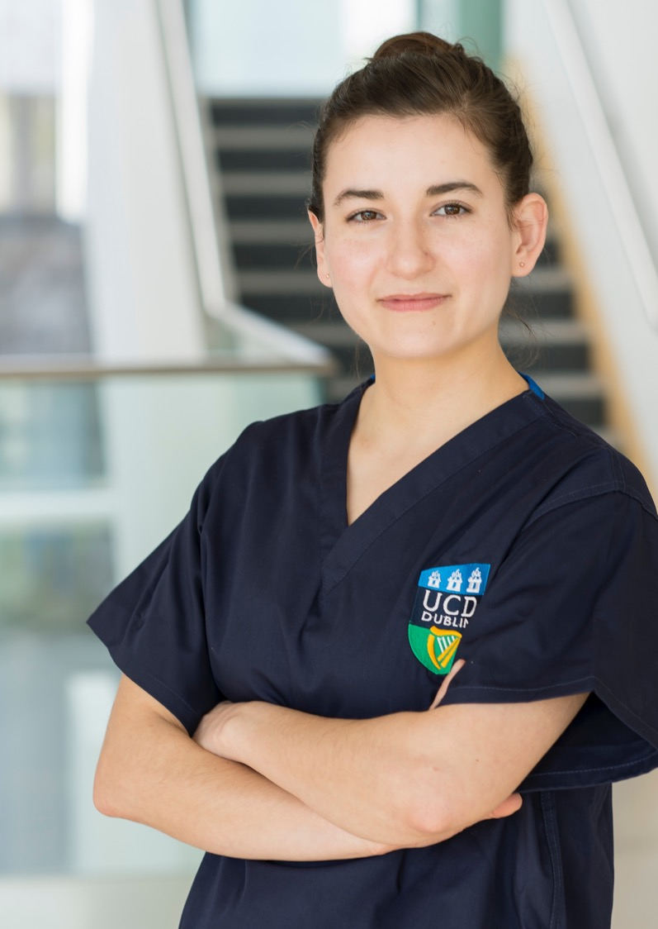
Main Title
Subtitle
Text body

Slide 5
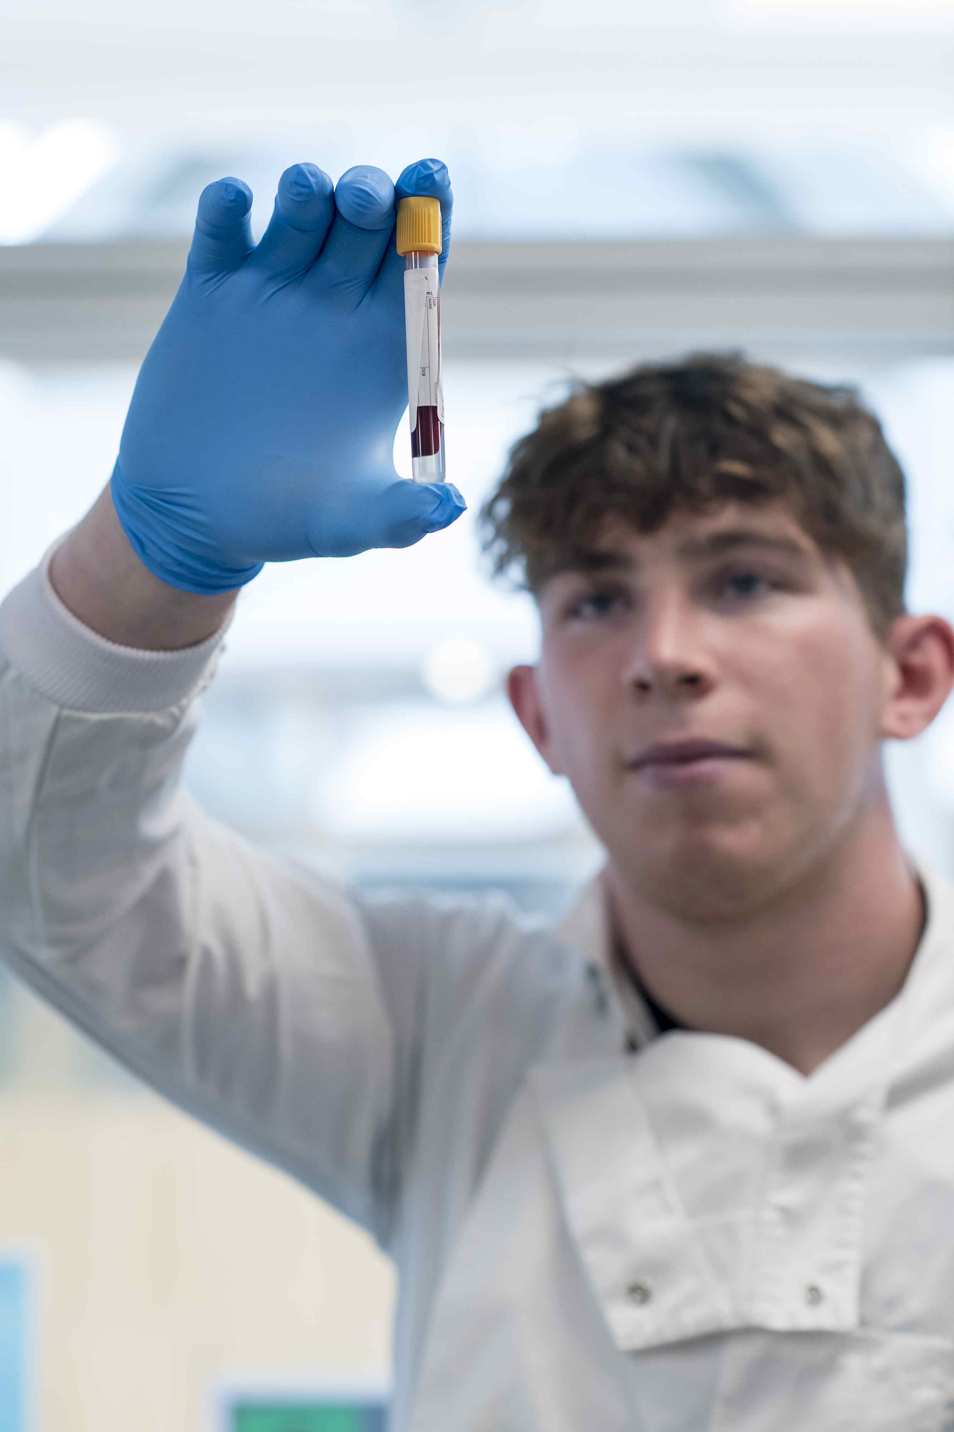
Main Title
Subtitle
Text body

Slide 6
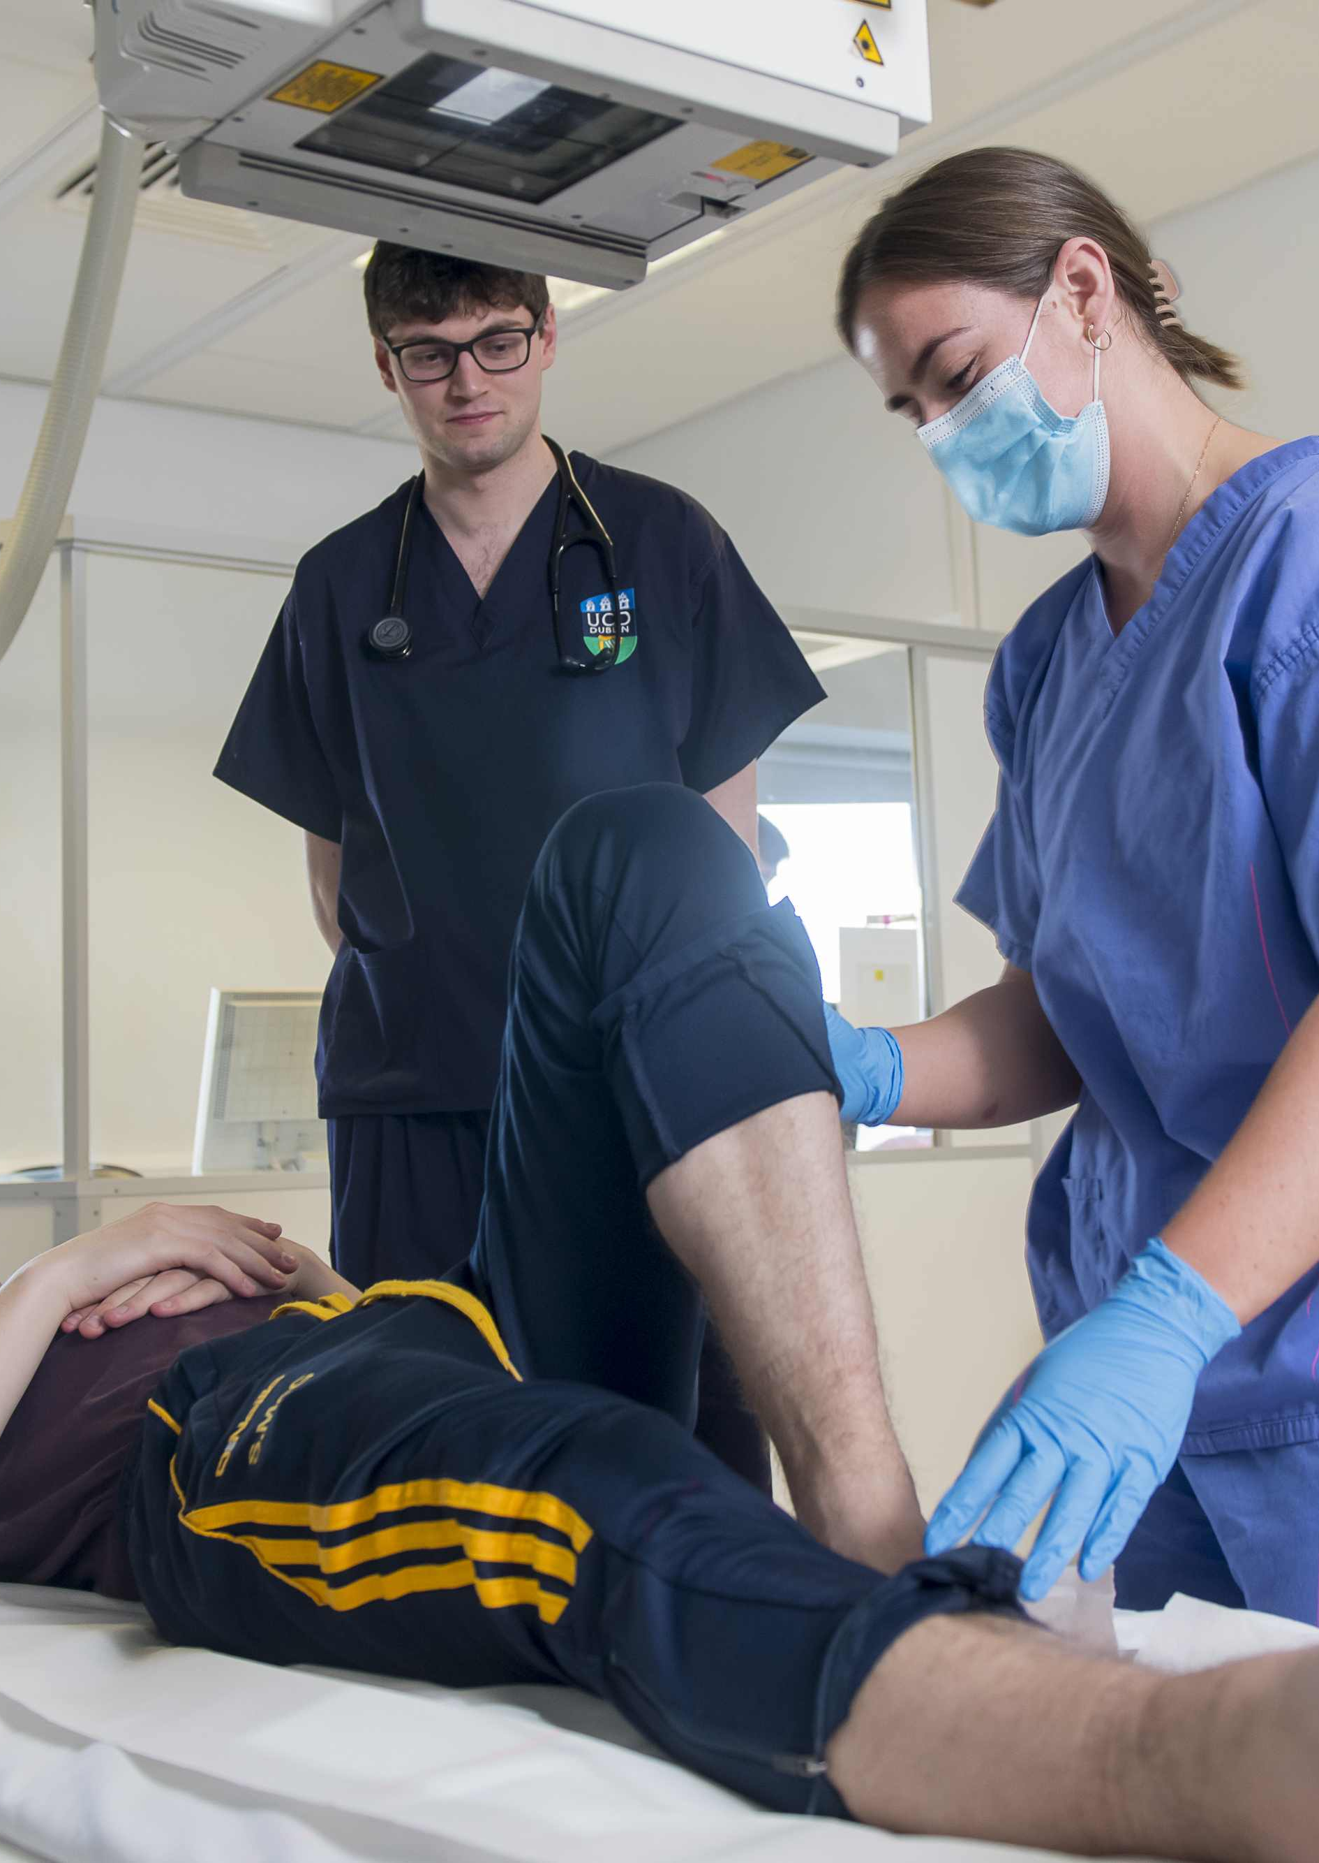
Main Title
Subtitle
Text body

Slide 8


Slide 9

Thank You.
w: ucd.ie/medicine

